Slide 1
Building Blocks of Malware
Orville Dillon, Jr.

Slide 2
File types
*.EXE – Executable: Executable binaries which are loaded as a process.
*.DLL – Dependency modules loaded into processes but can’t be loaded independently.

Slide 3
Development Process
Code
Compilation
[PE] Executable | or | [DLL] Dynamic Link Library

Slide 4
ENTRYPOINTS
EXE:
main()
DLL:
DllMain()

Slide 5
Droppers and payloads
Malicious code carrier which drops(delivers) malicious code to a device.
Payloads are the contents of a dropper.

Slide 6
Payload example
Notes:
Shellcode sample from: MAGIX Music Editor 3.1 – Buffer Overflow (SEH) @ https://www.exploit-db.com/exploits/46056

Slide 7
Payload objective
Execute and maintain persistence.
1
Execute, persist, [sleep], communicate with command & control server via shell.
2
System reconnaissance: Search for strings which match Regular Expression patterns – Credit card numbers, account logins, cryptocurrency wallets, etc.
3

Slide 8
Function placement In Code
.TEXT : main()
.DATA : Make payload/shellcode as a global variable; This will be read-only data in the PE file.
.RSRC : Dedicated to icons and images; In initialized functions.

Slide 9
Integration
Windows/Operating System API
*From .TEXT*, copies payload into new memory buffer then executes from that memory buffer.
A buffer which is readable, writeable, and executable isn’t common.

Slide 10
Detection difficulty
Encoding (Base 64)
Encrypting (AES, RSA)
Code Obfuscation
Function Call Obfuscation

Slide 11
External functions
Show up on the Import Address Table(IAT)

Slide 12
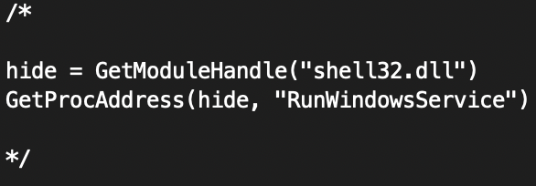
Function Call Obfuscation example:

Slide 13
Payload injection
Requiremets:
Allocate Memory
Copy Shellcode/Payload
Execute
APIs:
VirtualAllocEx
WriteProcessMemory
CreateRemoteThread

Slide 14
Methods of implanting:
Code Caves
Code Injection
section extension

